Slide 1


Slide 2

Death of the DMZ: Protecting Internal Apps with Azure AD Application Proxy
Raymond P.L. Comvalius - MVP
IT Infrastructure Architect/Trainer
@nextxpert

Slide 3
Agenda
Cloud as the new perimeter
App Proxy Concept
Implementing App Proxy
Lessons learned

Slide 4
Cloud: The new perimeter
Our best protected resources are in the cloud
Best Authentication
Conditional Access
Identity Protection
Best DDOS mitigation

Slide 5
Azure AD Application Proxy
Simple Connector(s) on-prem
Only connects outbound
Simple redundancy
Easy for users
Easy to configure
HTTP-only

Slide 6




Azure AD App Proxy Concept
Pre-authentication
Colleague
Conditional Access
Identity Protection
Active Directory
Domain Services
Azure AD Connect
Azure Active Directory
On Premises
Internet
App Proxy connector

Slide 7
Authentication Support
Pre-authentication in Azure AD
Choose your authentication protocol:
No Authentication
Windows Integrated Auth
SAML
Admin Managed Passwords
Header-based (with PingAccess)

Slide 8
The App Proxy Connector
Install
Register
Update
Network Config
Grouping Connectors

Slide 9
Installing the Connector
Single file download (~6 MB)
Installs on Server Core
Manage with PowerShell

Slide 10
Network Configuration
HTPS Destinations
*.msapproxy.net
*.servicebus.windows.net
login.windows.net
secure.aadcdn.microsoftonline-p.com
*.microsoftonline.com
*.microsoftonline-p.com
*.msauth.net
*.msauthimages.net
*.msecnd.net
*.msftauth.net
*.msftauthimages.net
*.phonefactor.net
enterpriseregistration.windows.net
management.azure.com
policykeyservice.dc.ad.msft.net
HTTP Destinations
crl.microsoft.com
mscrl.microsoft.com
ocsp.microsoft.com
www.microsoft.com
Required Network Connectivity over port 80/443
Supports (unauthenticated) proxy
Notes:
Use ConfigureOutboundProxy.ps1
Configures ApplicationProxyConnectorService.exe.config

Slide 11
The App Proxy Connector
Install
Register
Update
Network Config
Grouping Connectors

Slide 12




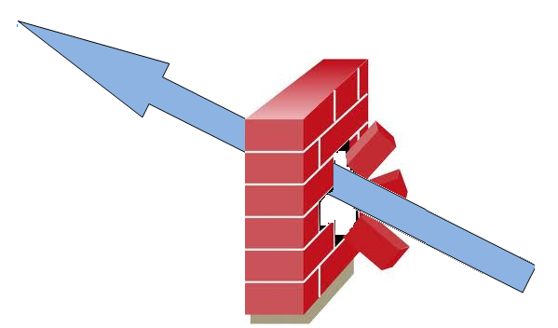
Publishing with Azure AD App Proxy
App Proxy Service
App Proxy Connector
Internal Application
Client Device
DNS
Create CNAME record **
Define Application
Configure KCD*
Authorize Users
Add Certificate **
Assign Conditional Access Policy
* For SSO with Kerberos
** For custom domain names

Slide 13
Configuring the Azure AD App Proxy Application
Choosing a domain
Certificate
Assigning Users
Conditional Access

Slide 14


Choosing the domain
Msappproxy.net includes the certificate for https
Application get a URL that differs from outside
URL does not match the known conventions
Less painfull when used from the MyApps Portal

Slide 15

Choosing the certificate
It’s for free when for *.msappproxy.net
Wildcard certificates are supported
SAN certificates are supported
Personal Information Exchange Format (PFX) must be imported for each published application
No support for Let’s Encrypt

Slide 16
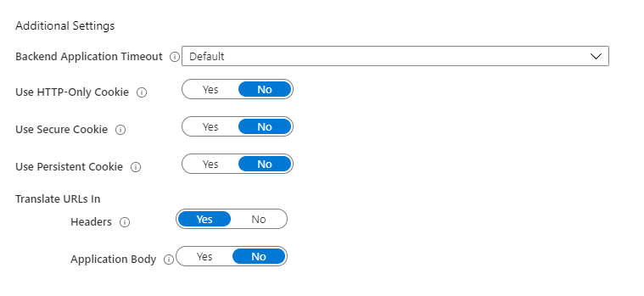
Additional Configuration

Slide 17
Challenges
When the internal URL differs from the external URL
When using msappproxy.net hostnames

Slide 18
Demo

Slide 19
Install on Windows Server Core
Silent install
Register Connector
Create Token

Slide 20
Install on Windows Server Core
Silent install
Register Connector
Create Token
AADApplicationProxyConnectorInstaller.exe REGISTERCONNECTOR="false" /q

Slide 21
Install on Windows Server Core
Silent install
Register Connector
Create Token
Credential object or Offline Token
https://docs.microsoft.com/en-us/azure/active-directory/manage-apps/application-proxy-register-connector-powershell

Slide 22
Install on Windows Server Core
Silent install
Register Connector
Create Token
.\RegisterConnector.ps1 -Authenticationmode Token -Token $SecureToken -TenantId <tenant GUID> -Feature ApplicationProxy

Slide 23
Automating App Publication
Automation is done from the AzureAD PowerShell Module
Get-AzureADApplication
New/Get/Set-AzureADApplicationProxyApplication
New/Get-AzureADApplicationProxyConnectorGroup
Set-AzureADApplicatoinProxySingleSignOn
New/Get-AzureADServiceAppRoleAssignment
Add-AzureADServicePrincipalOwner
Set-AzureADApplicationProxyApplicationCustomDomainCertificate
(only runs as local administrator)

Slide 24
Challenges
Certificates
Performance Monitoring
Delegation

Slide 25
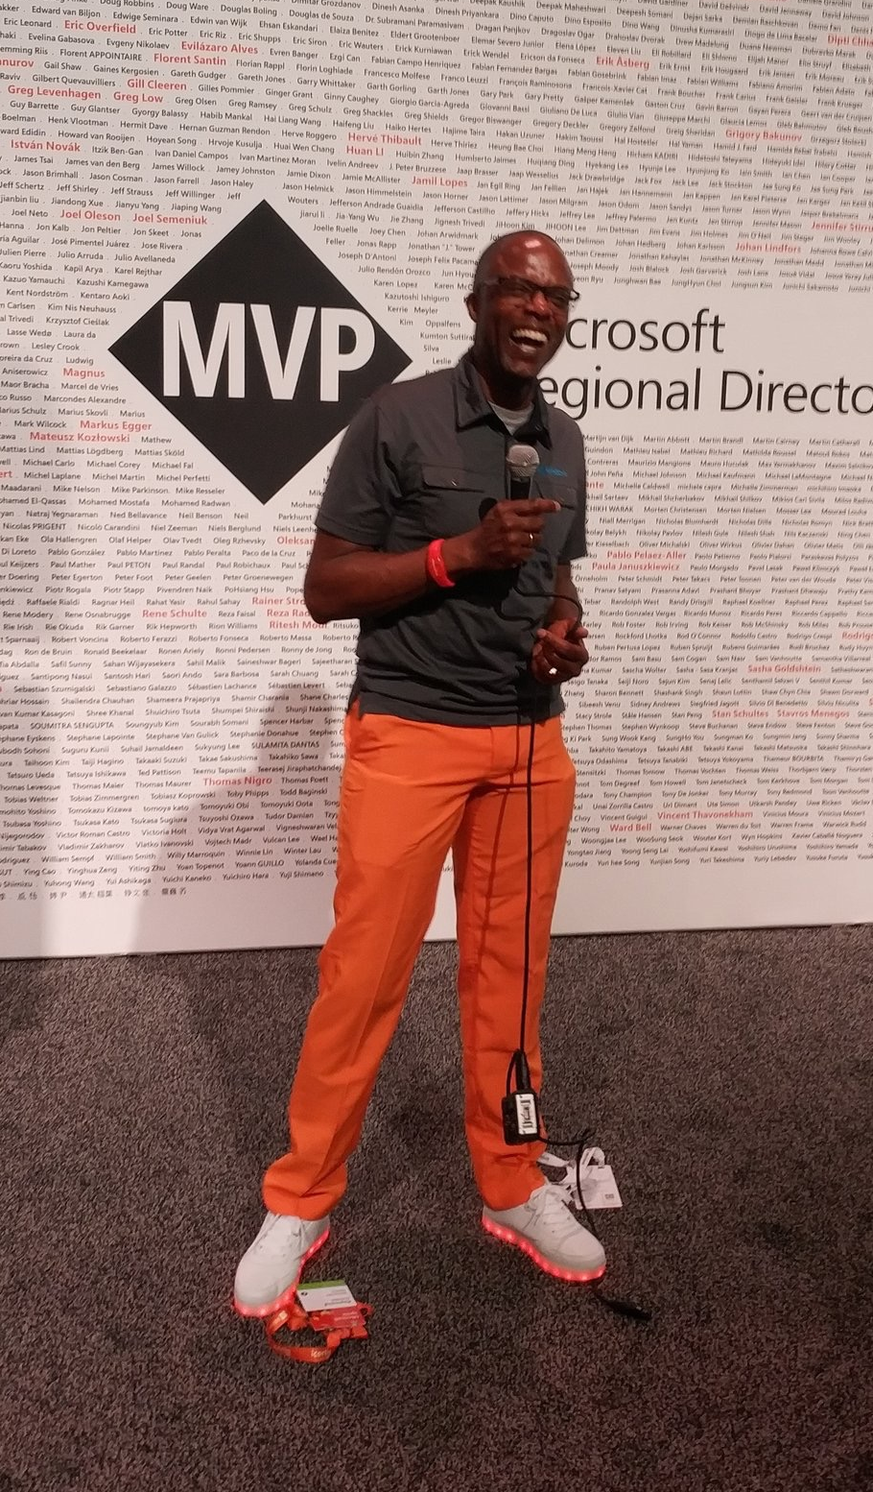
Summary
Implement
Operate
Secure

Slide 26
Slides and demos from the conference will be available at
https://github.com/nordicinfrastructureconference/2020

